Slide 1

Capstone - First and Last Touch
Attribution project
Learn SQL from Scratch
Carly Hadwin
Feb 2019

Slide 2
Table of Contents
Who are CoolTShirts?
What is the user journey?
Optimize the campaign budget

Slide 3
1. Who are Cool Tshirts?

Slide 4
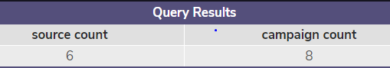
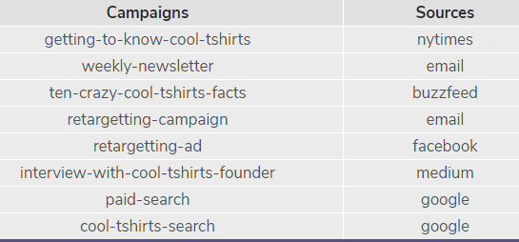
Who are Cool TShirts? They are an innovative apparel shop
How many campaigns and sources does CoolTShirts use and how are they related?
Firstly – what is the difference between utm_source and utm_campaign within this data?
A source is the type of communication – this could range from a social media platform such as facebook or email.
A campaign is a specific targeted message designed for a specific group of end users. From this campaign a marketing team are looking for a specific type of response.
The same campaign can be ran across multiple sources, however when analysing this data, it appears it isn’t the case for Cool Tshirts.
A source can run multiple campaigns, for example a ‘retargeting ad’ can run on facebook.

Slide 5
What pages are on the CoolTShirts website?
1 – landing_page
3 - checkout
2 – shopping_cart
4 - purchase

Slide 6
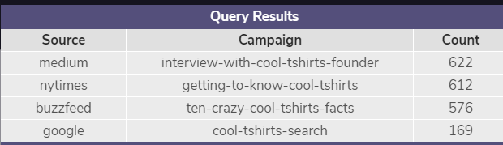
How many first touches is each campaign responsible for?
How many first touches is each campaign responsible for?
By looking at MIN timestamp for each user, the results we get show us the sources and campaigns that first capture the users attention. This equates to 1979 visitors.
*Interesting fact - that of the 8 active campaigns we identified earlier, only 4 of them are responsible for first touch – so a 50% success rate in terms of first touch*

Slide 7
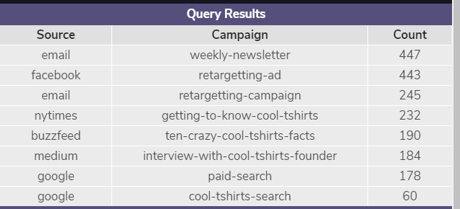
How many last touches is each campaign responsible for?
How many last touches is each campaign responsible for?
By looking at MAX timestamp for each user, the results we get show us the sources and campaigns that drive users back to the site for the last visit.
*Interesting fact - the campaigns which drove the first touch attribution are much lower ranked now when examining the campaigns which drove the last touches to CoolTShirts*

Slide 8
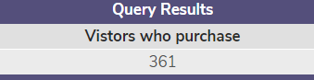
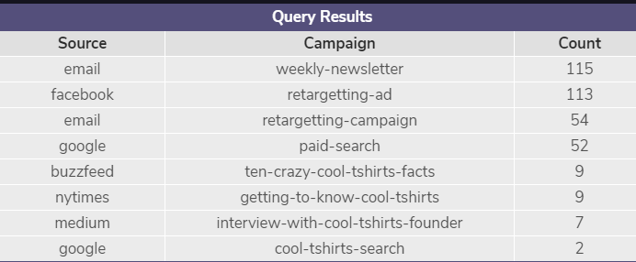
How many visitors make a purchase?
The total visitors who make a purchase is 361
Looking back at our first touches, we had a total of 1979 visitors. So if we compare the number of visitors who convert to customers, this is an 18.24% success rate. (361/1979 *100 is the conversion calc)
How many last touches on the purchase page is each campaign responsible for?
Steps for getting to this result:
Create temp table that finds last_touches per user_id
Add where clause to segregate max timestamp of user to purchase page
Create 2nd temp table to add source and campaign from page_visits then joins them on user_id and timestamp
Select and count rows where first_touch is linked to a source and campaign
18%

Slide 9
What is the typical user journey?
Looking back at the previous queries, of the 4 campaigns we recognised as “first touch” – 3 of these are informative/article campaigns. These 3 “article” campaigns are how 91% of users first come to the site. The other 9% is via the CoolTshirts Search
However, after initial contact users need reminders or prompts to draw their attention back to the website. This can be via social media, email newsletter or retargeting ads.
When we look at last touches and how many users complete a purchase, these last touch campaigns generate the most revenue. 78% of purchases were generated via Facebook retargeting, email retargeting or weekly newsletter.

Slide 10
3.Optimise the Campaign Budget

Slide 11
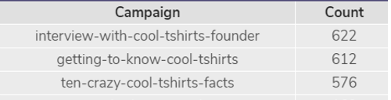
CoolTShirts can re-invest in 5 campaigns. Which should they pick and why?
When you look to choose 5 campaigns you believe would be beneficial for CoolTshirts to reinvest in, there appears from the results we have already found to be 6 high performing campaigns.
3 of these are the first touch campaigns in the article style which draw the users in to the website.
The other 3 are the last touch campaigns with the highest amount of visitors, the 2 retargeting campaigns (one via email and one via social media) and the weekly newsletter.
All 3 of the campaigns recognised in the first touch query are excellent at generating interest, so I think from an interest perspective these would be worth reinvesting in.
Retargeting is also another important step in marketing campaigns, and these campaigns tend to lead to the majority of purchases. Therefore if we had to limit to 5 I would take the 2 retargeting campaigns as you are then using 2 different sources/platforms.

Slide 12
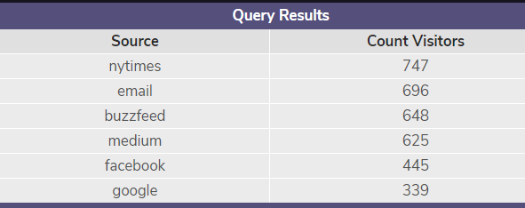

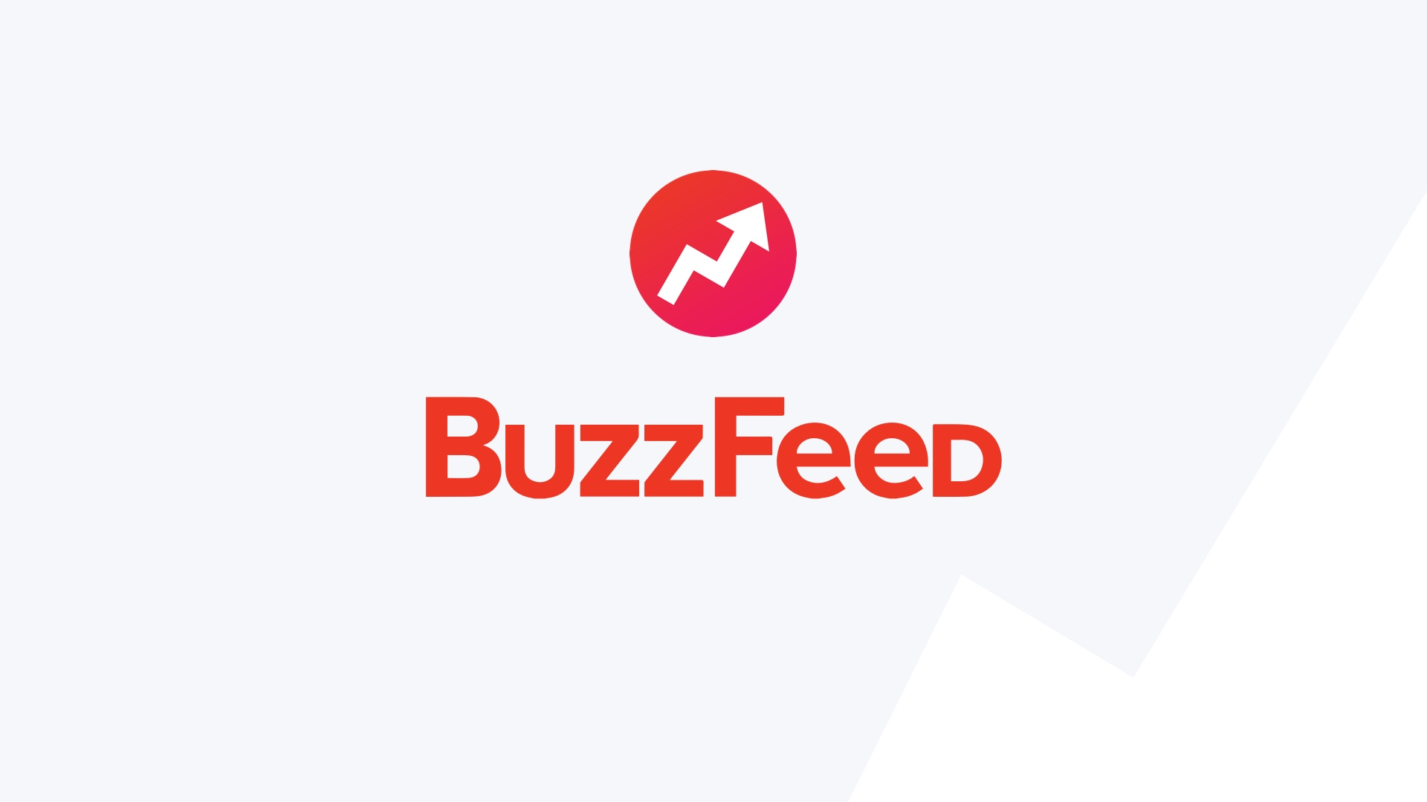

CoolTShirts can re-invest in 5 campaigns. Which should they pick and why?
Which sources generate the most traffic?
Looking at the below results, the nytimes has double the amount of hits over google/facebook.
When we refer back to the last touches that convert to purchases, the email campaigns and facebook retargeting ads are the most successful.
However, if we decided to go with the retargeting ads, it may be worth running these campaigns on a wider range of sources that generate more traffic such as Nytimes, Buzzfeed and Medium.

Slide 13
Disregarded campaigns
Both the paid search and the CoolTshirts search don’t rank highly when we convert the last touch to purchases. Also the fact that you are paying for a search engine to me doesn’t optimize the budget when there are higher performing campaigns to get the end result of sales.

